Slide 1
Top 30 Fast Food Chains in America
Ryan Woodward - V00857268
Notes:
Hello everyone, my name is Ryan and I’ll be critiquing a top 30 fast food chains in america visualization

Slide 2
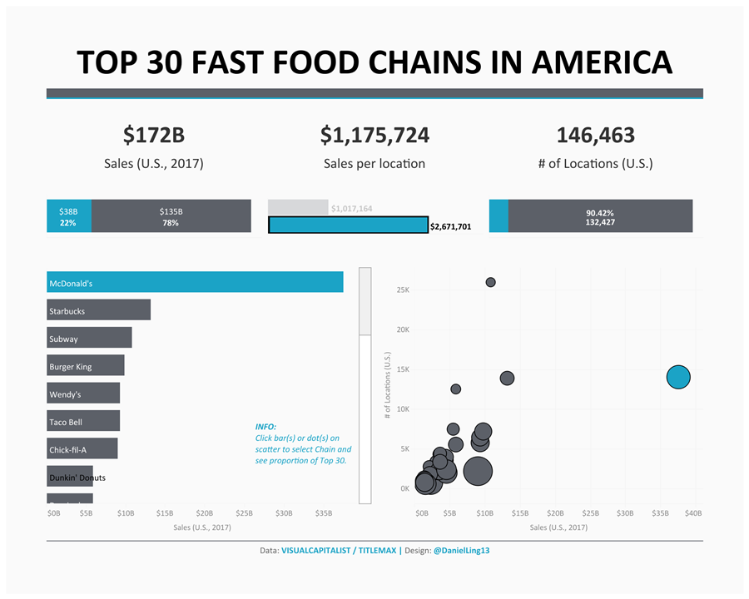
Notes:
The visualization that I’ve chosen uses the fast food brand for its data cases and has the following data dimensions: the sales, sales per location, and the # of locations, and finally the proportion of each of these sales values on a per data case basis. It is an interactive graph. And we can see that if we click on a different franchise the proportional bar graph will change

Slide 3
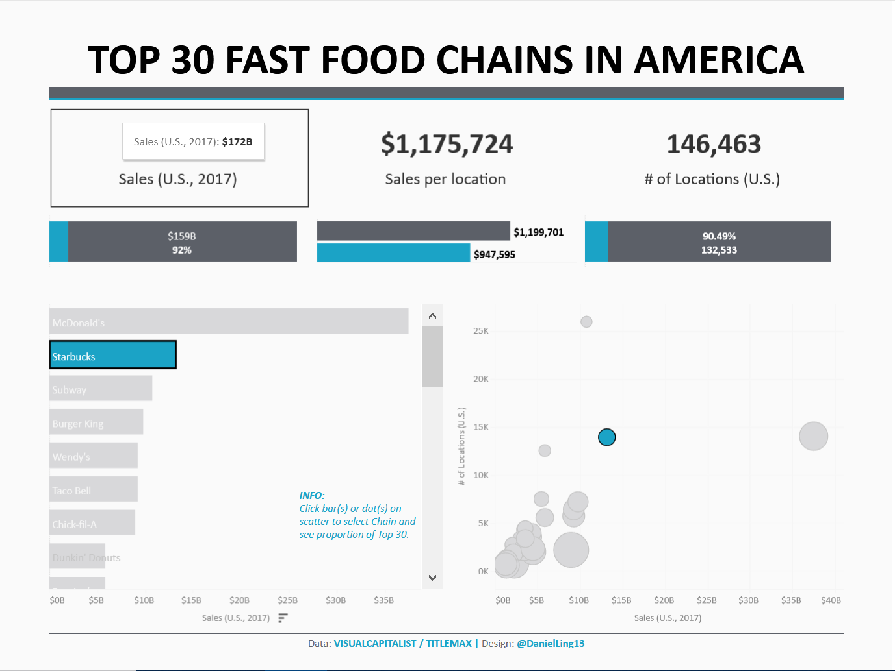

Slide 4
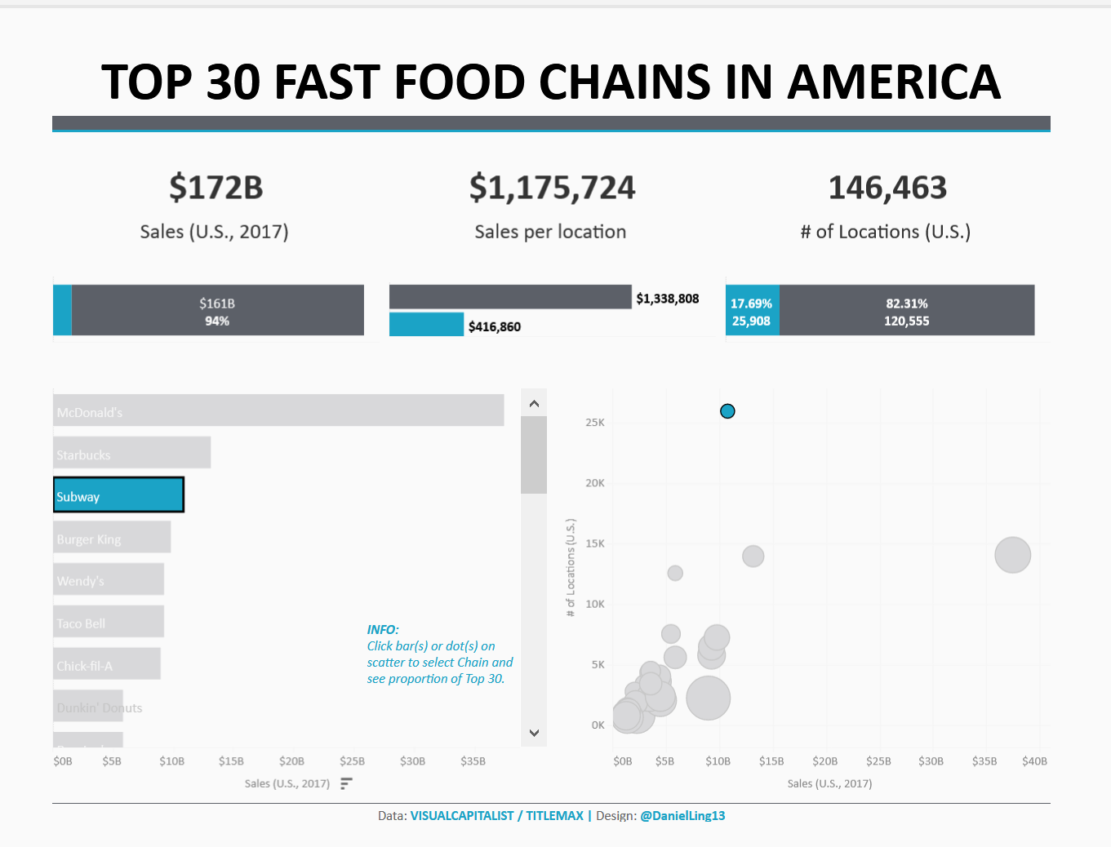
Notes:
Let’s dive into the problems. First off we see that when we click on individual franchises the proportional bar graphs change, but not the main sales. Furthermore after only the 2nd highest franchise the sales proportional bar graph is so small that we don’t really see any information anymore. Instead all we see is that 94% of the market is the rest of the restaurants and we are left to deduce subway at only 6%I felt like they could’ve normalized the numbers in order to indicate a greater aspect of change. Unless the point was to simply show Mcdonald’s dominance.

Slide 5
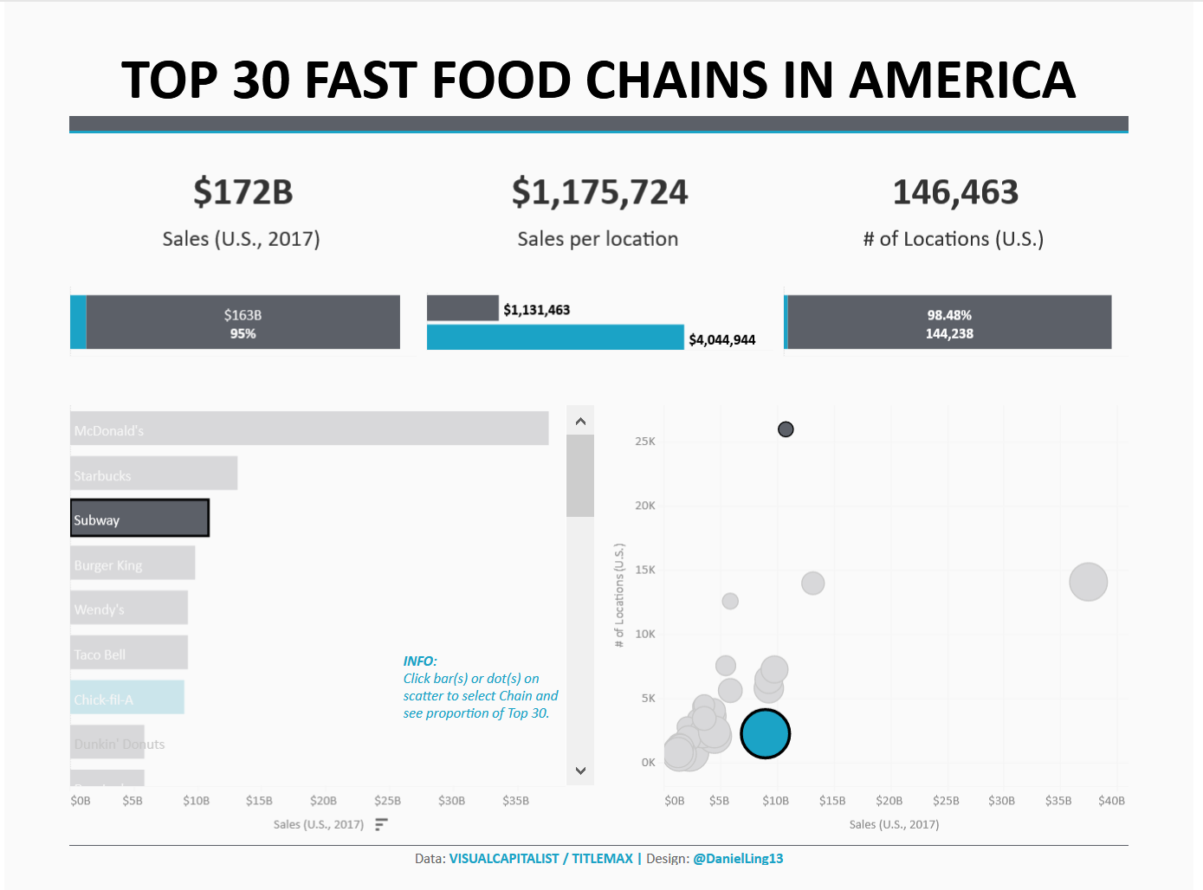
Notes:
Also it violates the circle area rule in the x/y scatter plot for sales per location. As noticed here chick-fil-a makes plenty of sales per location.

Slide 6
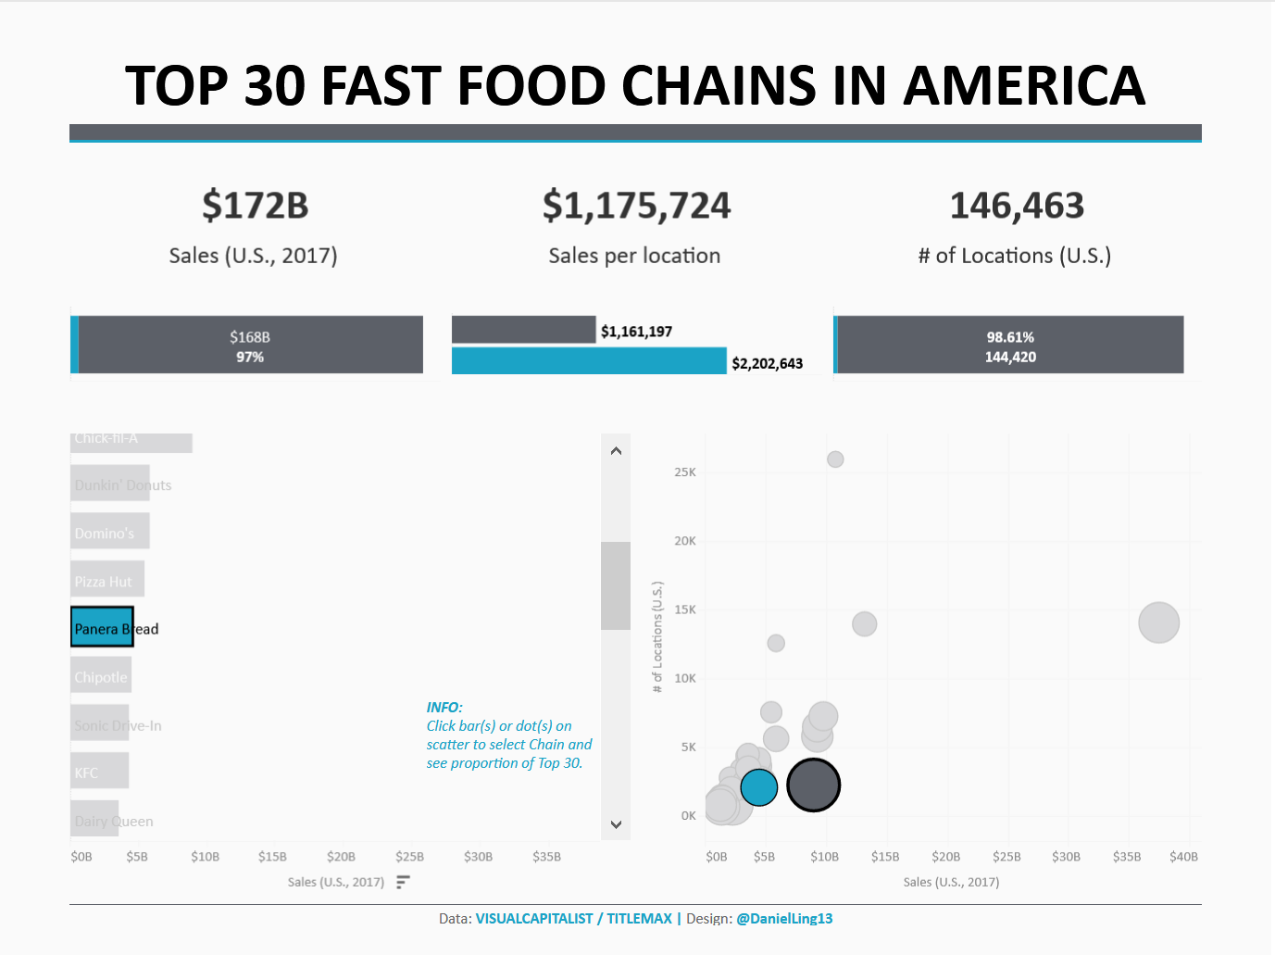
Notes:
Almost twice the amount of Panera Bread, however it’s difficult to pinpoint the size difference. I also have a problem with the xy scatter plot that they chose in this case. A lot of the restaurants are jumbled up in the bottom with no color difference, no different saturation unless you’ve selected a particular restaurant, and no real way to distinguish between them without hovering your mouse over them. There is a lot of empty space on the scatterplot that could’ve been better used.

Slide 7
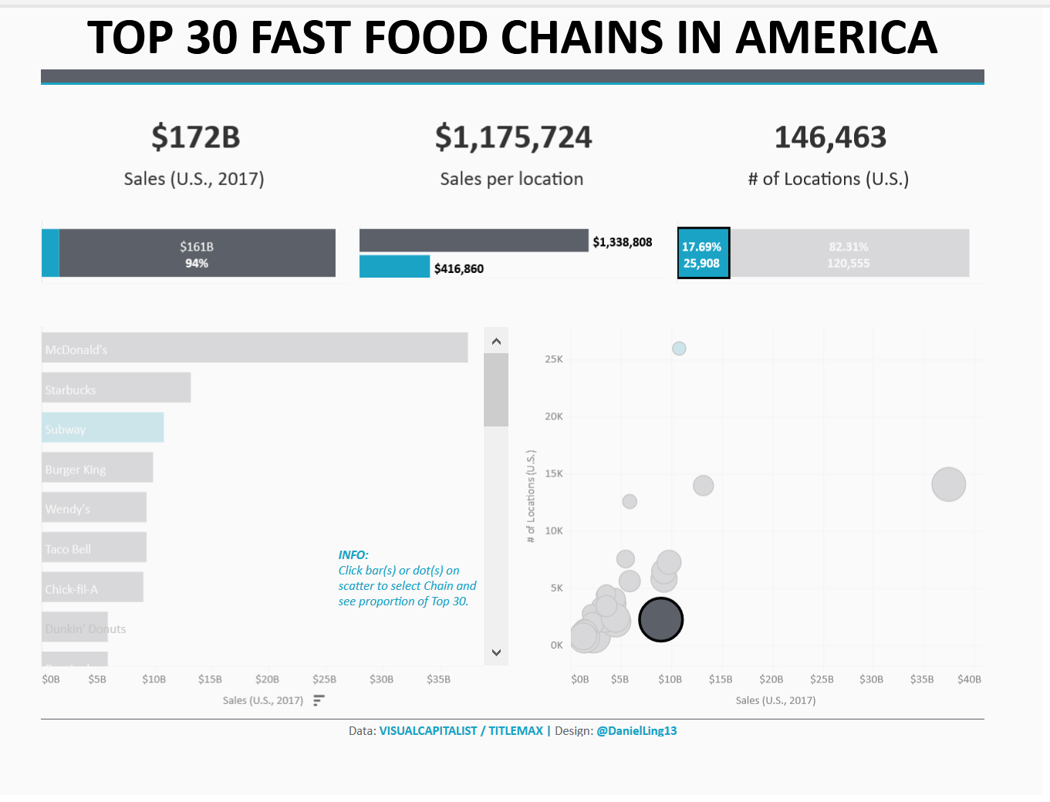
Notes:
Finally i was able to click on each of the bar graphs below the main sales but it didn’t change any information. It simply lightens the hue of the other colors on the screen. However if they are already light it doesn’t do anything additional. In summation I feel like this is a poor visualization, and the only information I was able to get out of it was that McDonald’s is dominating the market. And that Subway has a lot of locations. But you probably already knew that since there are 3 within 3 blocks of each other downtown.

Slide 8
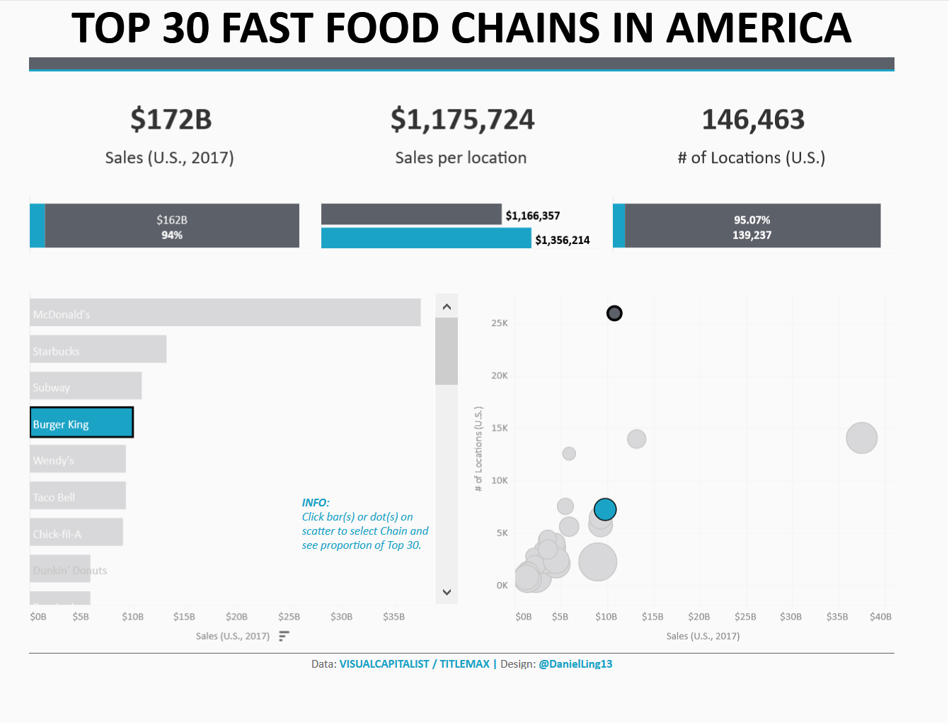
Notes:
There are also 2 burger kings downtown and we can see by and large they have 5 times less locations than subway. Which leads me to the conclusion that there are too many Burger Kings in downtown Victoria. Thanks for listening. I’ll take any questions that you have.

